Slide 1
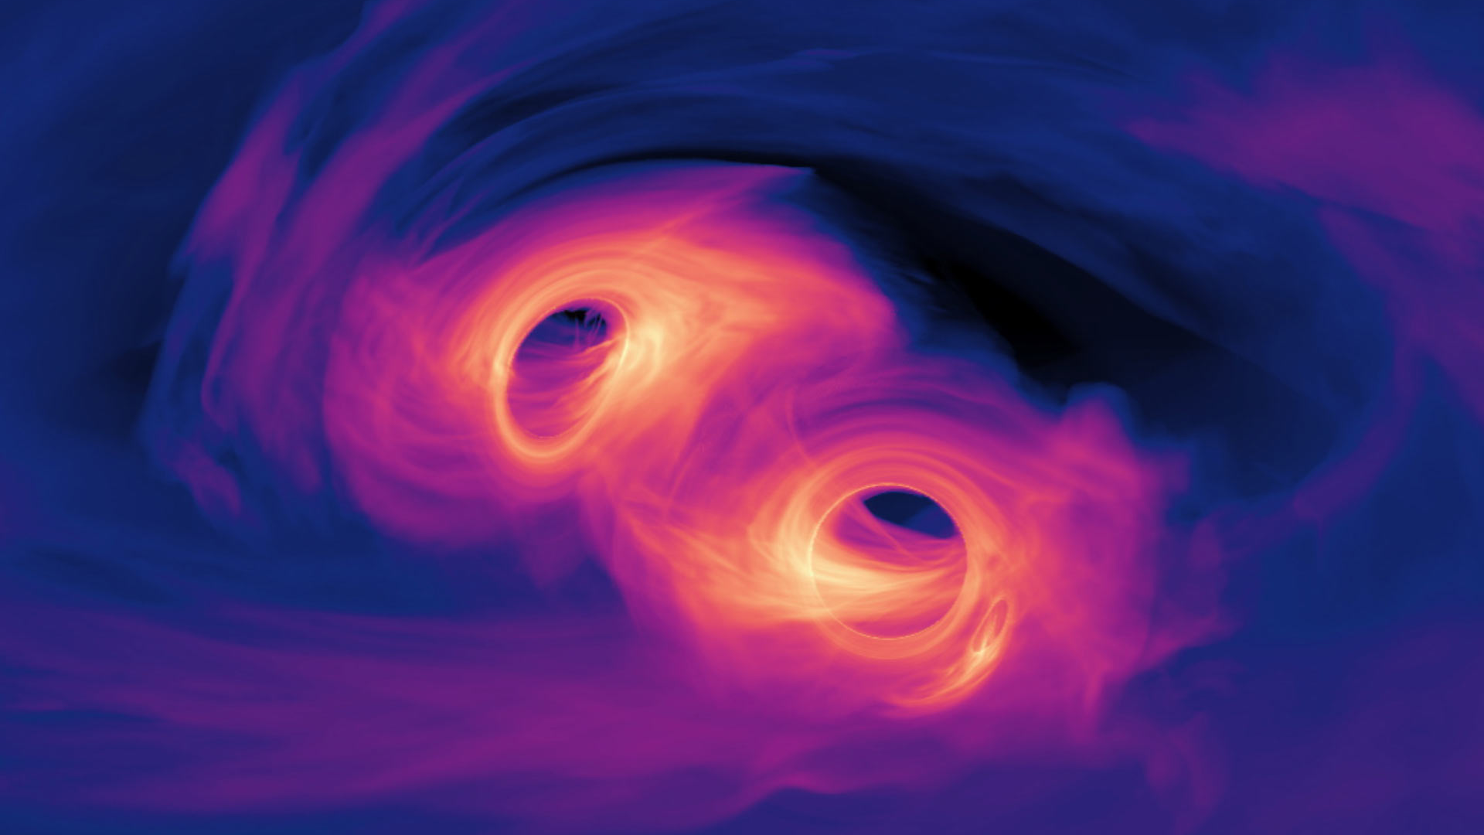
Studying the merger of two black holes
Thesis proposal, by Jordan Moncrieff
Supervisors: Bruce Gendre, Fiona Panther
Image credit: NASA’s Goddard Space Flight Center.
Notes:
Hello everyone, my names Jordan. I’m a bachelor or Philosophy honours student, studying theoretical Physics. My project is on the study of the merging of two black holes, under the supervision of Bruce Gendre, and Fiona Panther.

Slide 2
Introduction

Slide 3

Binary black holes
Notes:
In this project, we are interesting in two rotating black holes that orbit one another in a black hole binary.
As these black holes orbit one another they are obviously experiencing acceleration. And just like how accelerations of charged particles producing a change in the electromagnetic field that is propagated out at the speed of light in the form of electromagnetic radiation, changes in the gravitational field from accelerating masses results in the emission of gravitational radiation – called gravitational waves.
The two black holes orbiting each other lose energy from emitting gravitational waves, causing there orbits to close in on one another before finally colliding, and merging into a single spinning black hole.
This results in several solar masses of energy being lost from the system, and the emission of more energy in the form of gravitational radiation than the combined power from all the stars in the universe.
Signals from these mergers are what is detected by the interferometers at LIGO and VIRGO.
Now gravitational waves, as I mentioned are really similar to electromagnetic waves. And this is no accident, it is a hint at the connection between general relativity and electromagnetic phenomena. I’m going to be spending the rest of this presentation talking about this relationship. To flesh out this relationship, I’m going to go on a bit of a detour, and discuss a field closely tied to electromagnetism – magnetohydrogynamics and plasma physics.

Slide 4
Unanswered questions
How can SMBHB collide in Hubble time (final parsec problem)
Do BBH mergers result in EM emission?

Slide 5
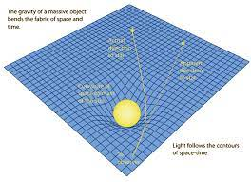
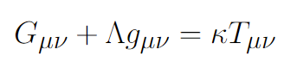
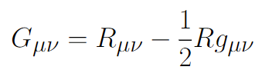

General relativity
Spacetime tells matter how to move
Matter tells spacetime how to curve
Curvature of spacetime
Dark energy
Energy source
Ricci tensor = spacetime
Metric $g_{μν}$ = gravitational field
Image credit: R Nave
Notes:
To start, I will really quickly talk about general relativity and black holes.
General relativity is governed by Einstein’s field equations, shown here. This equation says that the curvature of spacetime, which we can identify with the Einstein tensor, is related to matter and energy sources, given by the stress-energy tensor on the right. This equation just says, in the words of John Wheeler “space-time tells matter how to move, and matter tells space-time how to curve”.
So a mass like the Earth curves the space around it, and other masses within the vicinity of the Earth - like a satellite orbiting - will feel this curvature, and move in straight lines in this curved space (geodesics), which corresponds to the forces of gravity we observe in the world – as shown in this picture on the bottom right.

Slide 6
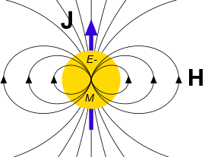
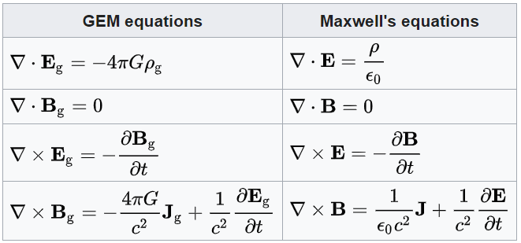
EM and GR analogy
Many strong analogies between gravity and EM.
Gravitoelectromagnetism (weak field limit of GR) produces equations very similar to Maxwell’s.
Gravitoelectric and gravitomagnetic fields appear.
Experimentally identified effects, such as spin precession and Lense-Thirring effect.
Image credit: https://en.wikipedia.org/wiki/Gravitoelectromagnetism
Notes:
Firstly, why would one expect there to be any link between Plasmas and Gravitation? To answer that, lets look at the link between electromagnetism and general relativity that I alluded to before.
The link between electromagnetism and general relativity has existed for a long time, with Einstein spending the second half of his life trying to unify the two forces.
The analogy between the two fields is seen most clearly in the weak field limit of general relativity (the limit where we assume spacetime is close to flat, with a small perturbation), this leads to Einstein’s field equations reducing to the Gravito-electro-magnetic equations, a set of PDEs that are remarkably similar to Maxwell’s equations.
This introduces two fields associated with a gravitational mass, the gravito-magnetic and gravito-electric fields.
A non spinning black hole would have just an gravito-electric field, like how any charged object produces an electric field (Newtonian charge).
A spinning black hole, due to the effect of frame dragging, will have an associated gravito-magnetic field.
To see why this is, consider a positively charged sphere rotating about its axis. This rotation will create a bunch of current loops, which will produce a dipole – acting as a magnetic field. In the same way, frame dragging will produce its own sort of dipole field, deflecting incoming massive particles (i.e. particles with “charge”) as if it was a magnetic Lorentz force. But this is just what frame dragging is! A result of the fabric of spacetime rotating.
These effects have been shown experientially, producing the so called Lense-Thirring effect. This causes the spins of binary black holes to precess as they approach each other, similar to how the spin of an electron precesses in an external magnetic field (Larmor precession).

Slide 7
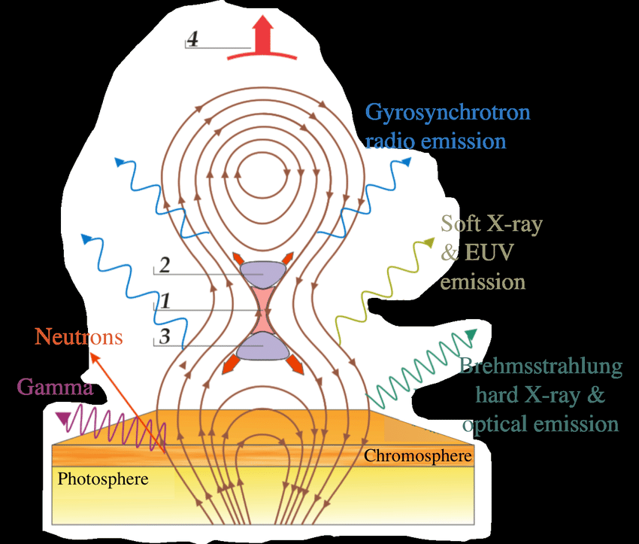
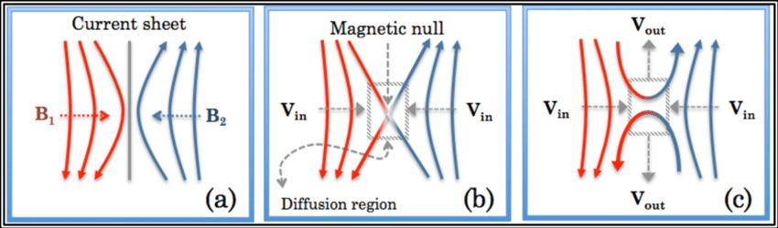
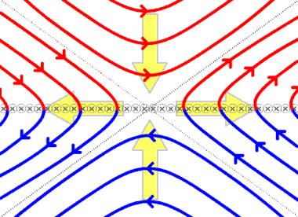
Magnetic reconnection
Magnetic field lines in plasma can snap, and reform into a new arrangement, releasing large amounts of magnetic energy in the form of particle and EM emission.
Happens in current sheets, where magnetic field can go to zero due to resistivity, allowing field lines to be “cut and pasted” back together.
Occurs frequently in space, e.g. with solar flares in the sun.
Credit: Kevin J. Genestreti
Credit: https://en.wikipedia.org/wiki/Magnetic_reconnection
Credit: Allison Youngblood
Notes:
**Maybe rewrite this part for new diagrams – make briefer**
The last effect in Plasmas that I want to talk about is that of magnetic reconnection, where magnetic field lines break and reform in a different arrangement, producing energy in the process. To see how it works, consider the following situation where magnetic reconnection occurs:
Magnetic field line rapidly decreasing down from the top of page (moving right), until it flips direction and begins increasing in magnitude down the page (blue region).
In center there is zero magnetic field, and due Amperes law there is a current sheet moving into the page. Due to magnetic pressure, pressure much higher outside current sheet then within, resulting in a force sucking the plasma towards the central current sheet along with the frozen in magnetic field lines.
As the frozen in field line reaches near the current sheet, ideal MHD breaks down (resistivity becomes finite) and the diffusion term in the ideal induction equation becomes relevant. This results in both the upper and lower magnetic fields decaying in the horizontal direction (possibly just ohms law?)
Zero horizontal magnetic field means the diagonal components of each magnetic field can join up (cut and pasting of field lines), and magnetic tension will then pull the resulting joined field lines across the current sheet.
The plasma moves with this frozen in magnetic field out from the centre, resulting in a drop in pressure, dragging more of the field lines towards the centre, completing the process
This process is shown here in this animation, magnetic field lines are sucked into the current sheets, the horizontal components or the magnetic fields drop to zero from resistivity effects, and this allows the vertical components of the magnetic fields to smoothly join together, at which point magnetic tension drags these fields outwards off into space.
Magnetic reconnection shows up all over the place in Astrophysics. The most famous example is probably in Solar flares, shown in this next image. At sunspots, locations in the sun with intense magnetic fields (resulting in a lower temperature from cooler regions deeper in the sun, resulting in the visible dark patches on surface of sun) coming out of the photosphere can reconnect with itself and releasing its magnetic energy in the form of emission of charged particles and EM radiation. (Think of magnetic energy release like the snap when a twisted rubber band snaps).

Slide 8
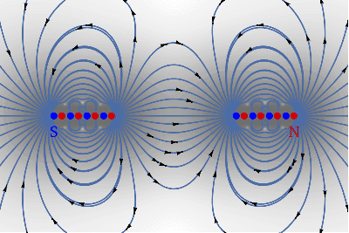

Gravitational reconnection
Can observe magnetic field lines snapping at null points as two bar magnets approach.
Could analogous effect occur with orbiting pair of binary Kerr black holes (gravitational analogue of a dipole).
Reconnection at null points between black holes could cause an ejection of material.
Demonstration of reconnection between dipoles, taken from stack exchange post: https://physics.stackexchange.com/questions/559741/what-is-happening-when-magnetic-field-lines-snap-or-break
Cartoon illustrating how reconnection of gravitational field lines might look between binary (Kerr) black holes
Notes:
To see how gravitational reconnection could occur, lets view a simple case of reconnection that occurs in electromagnetism.
This animation at the top shows essentially two bar magnets (modelled as a chain of dipoles) oriented in opposite directions approaching one another.
Notice that a null spots (indicated by green dots) appear on either side of the magnets, with these points of zero field approaching the centre as the magnets come together.
At these null points, since there is zero magnetic field, the magnetic field lines that previously belonged to a single bar magnet “snaps” and reforms into a field line connecting the two separate bar magnets.
A particle trapped that travels to a null spot will momentarily be free of the field, and could then potentially escape the system under the right circumstances.
Consider now a pair of binary black holes. Classically, we know there is a null spot in the gravitational field at the centre of mass of the binary system, and the combined frame dragging from each of the black holes could produce null spots and different locations. At this gravitational field null point, the field is able to snap and reconnect to change its topology.
The question is, could any material that was originally within this null point then be ejected by the system? Potentially forming some sort of jet travelling perpendicular to the orbital plane, maybe like the cartoon shown on the bottom right (like a coronal mass ejection, but for black holes).
The bottom right image is a bad animation I made illustrating the kind of process that could occur. Two Kerr black holes approaching orbiting each other act like dipoles due to frame dragging, and when these gravitational dipoles interact, like with the magnetic dipoles, the gravitational field lines reconnect. And this could result in restructuring of the gravitational field lines, potentially casing some kind of ejection of material from the Lagrange points between the two masses.

Slide 9
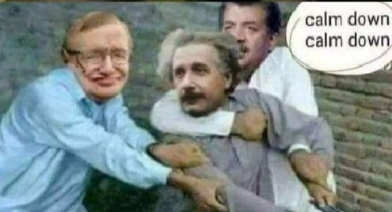

Slide 10
Progress

Slide 11
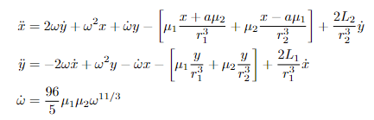
Basic model
Simplest model with all the necessary ingredients for reconnection.
Includes frame dragging (lowest order gravitomagnetic contribution), energy losses via gravitational wave emissions (resulting in inspiral), rotating reference frame (resulting in centrifugal, Corriolis, and Euler forces).
Derived the following dynamical system to model the trajectory of a particle in the presence of the gravitational field from two spinning point masses orbiting in a circular binary that is inspiralling due to emission of gravitational waves:

Slide 12
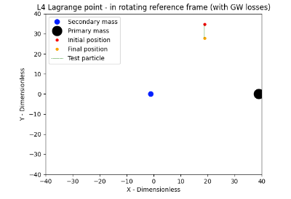
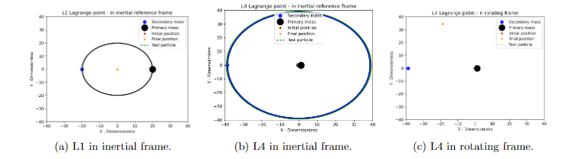
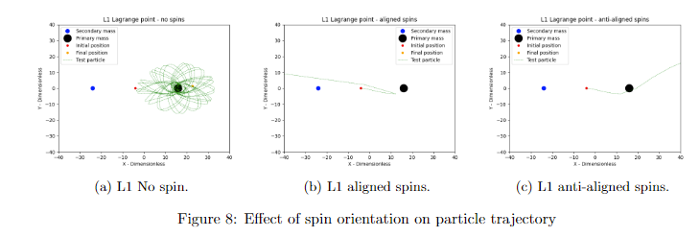
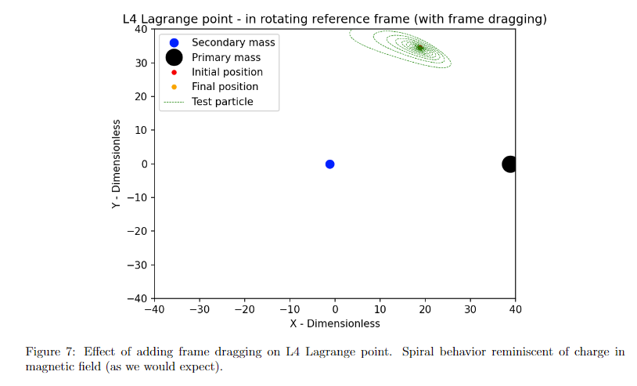
Basic model results

Slide 13
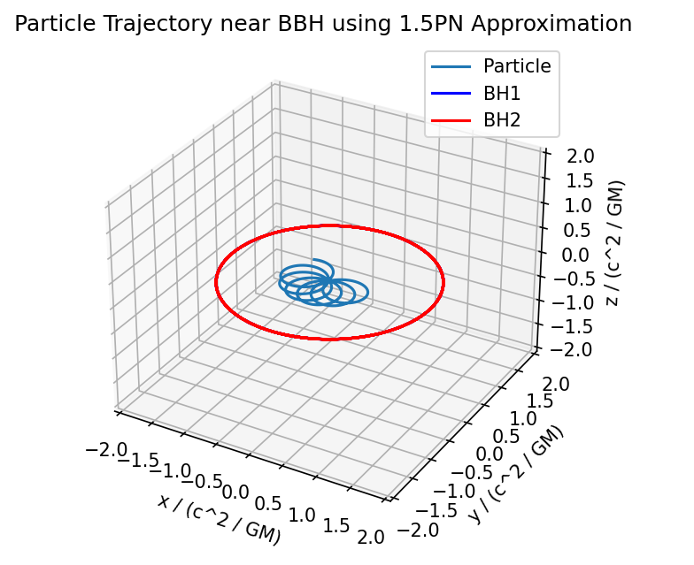
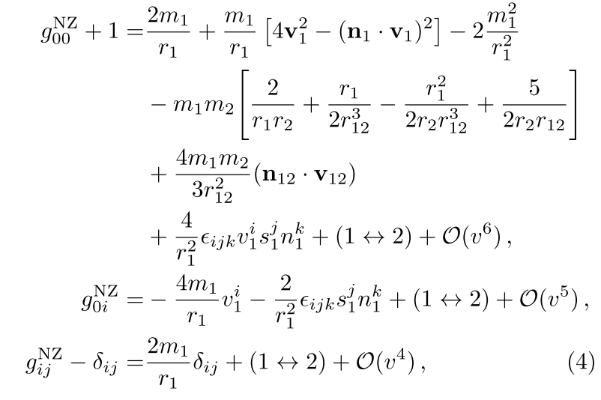
Improving the model
We can improve on the basic model by going to higher Post Newtonian (PN) orders.
Implemented the 1.5PN metric for binary black holes, using geodesic solver.
Code can simulate particle orbits in an arbitrary metric.

Slide 14
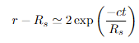
Black hole matter shell
Matter shell around black hole will not last the time it takes BBHs to merge.
Showed this using basic estimates and Schwarzschild metric.
Infalling matter gets within a Planck length of event horizon far before BHs merge, implying there must be a matter source present for there to be particles in vicinity of BHs.

Slide 15
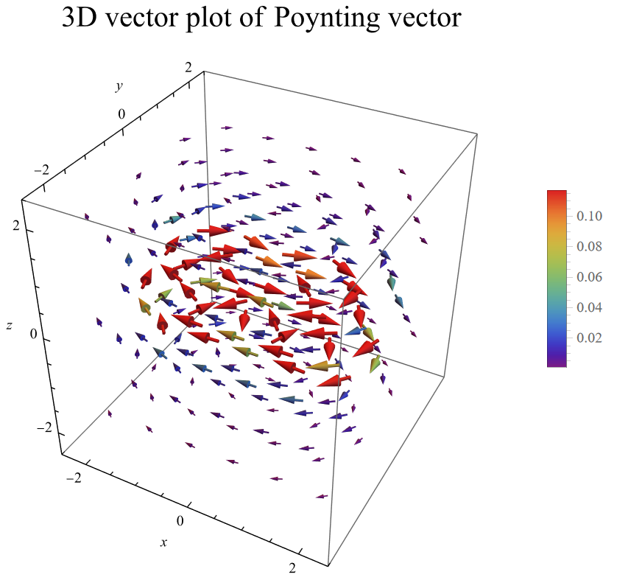
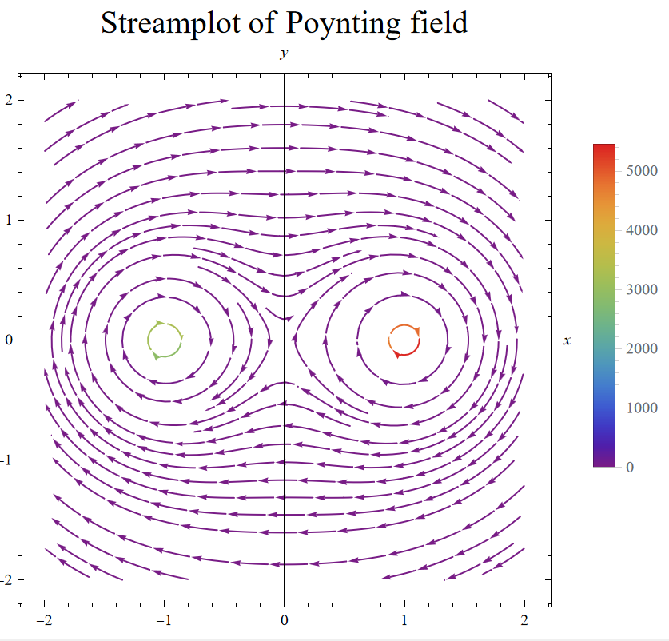
Energy flow

Slide 16
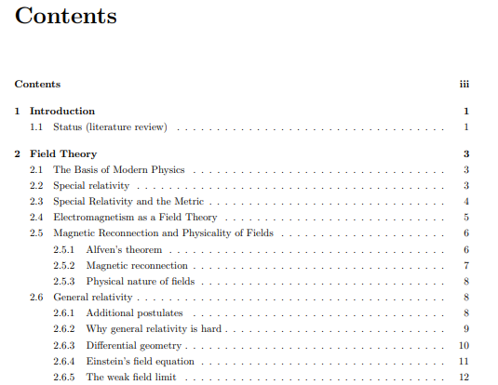
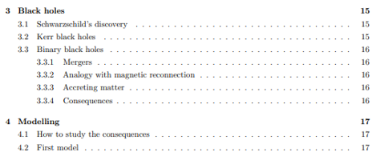
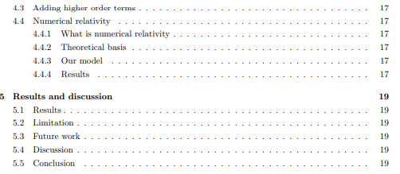
Thesis progress

Slide 17
Remaining work
Do more thorough tests with geodesic solver, test accuracy via comparing different methods and different metric approximations.
Perform calculations of energy flow more rigorously, e.g. by using the Landau-Liftschitz pseudotensor (in progress).
Continue writing thesis.

